Slide 1
Data Analysis Basics
Patrick Mathias
Lesson 0
DLMP R Lessons

Slide 2
Lesson Goals
Understand good practices for performing data analysis safely
Learn the basic “tidy data” model
Lesson Objectives
Organize data and projects in a safe way
Use basic strategies for data inspection when working with a new data set
Describe the 3 principles of tidy data
Notes:
In this first session our goal is to develop some familiarity with the R programming language.
We will also discuss the important role of reproducible data analysis and how R can help us with this.

Slide 3
Good Data Analysis Practices
Notes:
So now that you've met us let's discuss for a moment how this workshop is going to work

Slide 4
Practice #1: Build a project folder structure to organize your work
You will find it much easier to recycle previous work if you have a clear structure for organizing your projects
Make a folder for each project
Include folders within the project folder for at least the following:
Data (raw data)
Output (figures and/or intermediate tables or files) – can choose to put intermediate files into a separate folder
Analysis files – can choose to keep this in main folder

Slide 5
Practice #2: Data Analysis Should be Separated from Raw Data
No matter how you choose to analyze your data you should always create a new file for your analysis
Why?
Traceability: it is more difficult to identify mistakes in an analysis if you can’t look back at what you originally received
Mistakes: if you overwrite an important cell or field you may not be able to identify the mistake and may not be able to fix it without re-requesting the data

Slide 6
How do you separate your analysis from raw data?
In Excel: use “Save As…” immediately after you receive your data
In R or other programming languages, reading a file in generally does not change the original file
This is very helpful and can help enforce good practices
If you need to create an output file, you can use a write to file function
Name your output/analysis file with a name that you’ll be able to recognize a year from now

Slide 7
Should you save intermediate versions of your Analysis?
There is always a risk you will make a mistake in an analysis and want to backtrack
For analysis in Excel, consider a couple strategies:
Save intermediate analysis files with dates to track
Use OneDrive – you can save the same file and revert to a previous version
Analysis with a programming language emphasizes saving a script rather than a data file – you can re-execute the script if needed
May still want to use OneDrive or a version control system (e.g. git) for your script

Slide 8
Practice #3: Always Inspect your Raw Data
Before diving into a data analysis, lay eyes on the data set
Can open the file in Excel
Programming language development environment may also allow you to look at the raw data – e.g. Rstudio
Understand the meaning of rows and columns – will cover tidy data later

Slide 9
Practice #3: Always Inspect your Raw Data
Inspect for any missing data
How is missing data represented? Blanks, NULLs (SQL), NAs (R), -1?
Programming languages provide functions that perform a summary of the data set
If applicable, sort data column by column
Most helpful if each column = specific field or data element
Helpful to see the “lowest” and “highest” values by column
Can identify unexpected data types

Slide 10
Computers Think about Data Differently
Regardless of the tool you use to analyze data (e.g. Excel vs. R), the tool will categorize your data into data types
Data types dictate the computer’s ”rules” for acting on your data
Common data types:
Character
Number (could be integer vs. numeric with higher precision)
Logical (TRUE vs. FALSE)

Slide 11
Some special data types are linked to specific behavior
Dates, times, or datetimes are common in lab data sets
Special rules required to sort these types: AM vs. PM, parsing hours, minutes, seconds
Categorical data, or factors in R, may have a special representation to enable quicker summaries/calculations
Normal, STAT, and Timed may be more appropriate to represent as a categorical variable than a character
Categorial representation may be more efficient to count and display as different variables on a plot

Slide 12
Principles of TIDY Data
Notes:
So now that you've met us let's discuss for a moment how this workshop is going to work

Slide 13
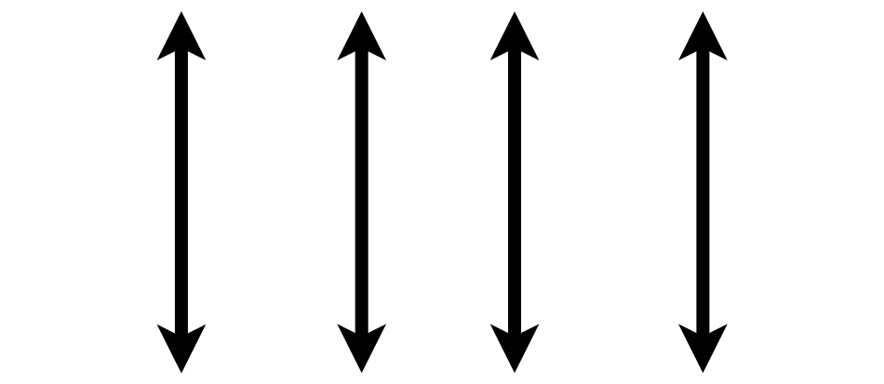

Tidy Data Summarized
A data set is tidy if:
Each variable is in its own column
Each observation is in its own row
Each value is in its own cell
MRN
Wickham, H. . (2014). Tidy Data. Journal of Statistical Software, 59(10), 1–23.

Slide 14
Consider a single data set with 4 variables
country
year
population
cases
Public health data set intended to represent the cases of a disease in a population by country and year

Slide 15
Representation 1
## # A tibble: 12 x 4 ## country year type count ## <chr> <int> <chr> <int> ## 1 Afghanistan 1999 cases 745 ## 2 Afghanistan 1999 population 19987071 ## 3 Afghanistan 2000 cases 2666 ## 4 Afghanistan 2000 population 20595360 ## 5 Brazil 1999 cases 37737 ## 6 Brazil 1999 population 172006362 ## 7 Brazil 2000 cases 80488 ## 8 Brazil 2000 population 174504898 ## 9 China 1999 cases 212258 ## 10 China 1999 population 1272915272 ## 11 China 2000 cases 213766 ## 12 China 2000 population 1280428583

Slide 16
Representation 2
## # A tibble: 6 x 3 ## country year rate ## * <chr> <int> <chr> ## 1 Afghanistan 1999 745/19987071 ## 2 Afghanistan 2000 2666/20595360 ## 3 Brazil 1999 37737/172006362 ## 4 Brazil 2000 80488/174504898 ## 5 China 1999 212258/1272915272 ## 6 China 2000 213766/1280428583

Slide 17
Representation 3 is Tidy
## # A tibble: 6 x 4 ## country year cases population ## <chr> <int> <int> <int> ## 1 Afghanistan 1999 745 19987071 ## 2 Afghanistan 2000 2666 20595360 ## 3 Brazil 1999 37737 172006362 ## 4 Brazil 2000 80488 174504898 ## 5 China 1999 212258 1272915272 ## 6 China 2000 213766 1280428583

Slide 18
Why keep things tidy?
Consistent mental model for data = common data manipulation becomes easier
Many tools in R (and Excel + other languages) make it very easy to do sophisticated analysis and visualization with tidy data
Databases that store data from clinical information systems often already represent data in a tidy form

Slide 19
Tidy Data Summarized
A data set is tidy if:
Each variable is in its own column
Each observation is in its own row
Each value is in its own cell
MRN
Wickham, H. . (2014). Tidy Data. Journal of Statistical Software, 59(10), 1–23.

Slide 20
Tips for Generating Your Own Data

Slide 21
Building your own data set
Data analysis projects beyond a certain complexity require creating your own variables or data frames (tables/spreadsheets)
In addition to building tidy data sets, consider steps to make future analysis easier

Slide 22
Naming Variables
Use variable (column) names that are easy for someone not performing your analysis to understand
“result_value” as opposed to “x”
“collection_time” instead of “time”
Stick to naming that will make it easier for a computer to read the data
Avoid spaces in names: “result_value” instead of “result value” (space has meaning in languages like R)
All lowercase (or uppercase) will be easier for you to type, even if it is not easier for the computer to parse

Slide 23
Respect Data Types When Creating Variables
Variable inspection and summarization is much easier (and less error prone) if known data types are used
run_id | value
1 | 5
2 | cancelled
3 | 11
4 | < 2
5 | 4
run_id | value | comment
1 | 5
2 |  | cancelled
3 | 11
4 |  | < 2
5 | 4

Slide 24
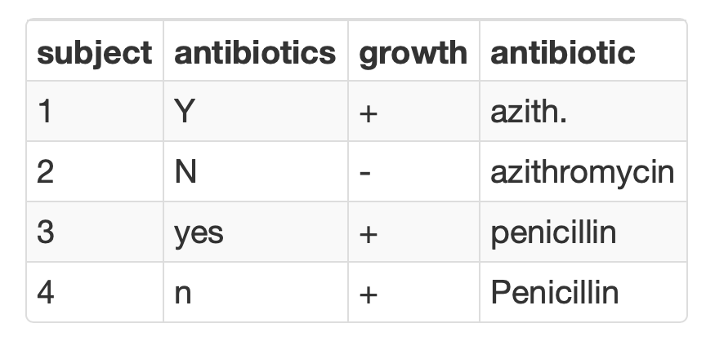
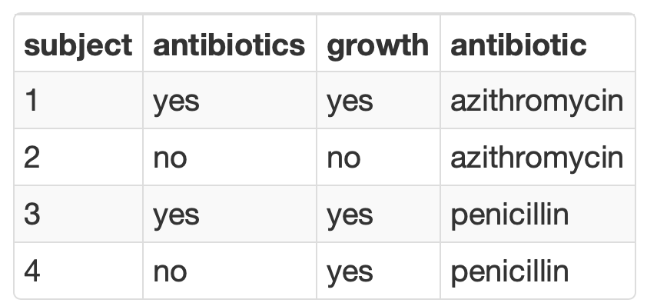
Consistency is Critical for Analyzing Categorical Variables
Summarization is seamless when consistent values are used to represent binary or categorical variables

Slide 25
Use Standard Formats for Dates and Times
Learn to know and love the ISO 8601 standard for representing dates and times
Prevent ambiguity when interpreting and parsing
Dates in filenames sort chronologically
Excel unfortunately does not encourage the use of this format (but should parse it without a problem)
Obligatory xkcd (https://xkcd.com/1179/)

Slide 26
R Course Introduction
Notes:
I'm here just to give you a quick introduction after which we'll dive right into the meat of the workshop.

Slide 27
Course Goals and Objectives
Establish good practices for working with data safely
Teach features of the R programming language that improve reproducibility in clinical data analysis
Demonstrate how R can be used to perform analyses of laboratory operational data
Establish a basis of understanding in the 'tidy' approach to data analysis
Notes:
Obviously we would love for those who are here today to all walk away and just start coding but the reality is that while that would be great we also have a set of more modest if more important goals
We're here to Advocate for the use of R as a means of improving reproducibility in clinical data analysis and I cannot emphasize enough how strongly we feel about this point
As we review this we will demonstrate how we can use R perform analyses of laboratory operational data
And we also hope to establish a baseline understanding of what tidy data is and how to implement a 'tidy' approach to data analysis within the framework of R

Slide 28
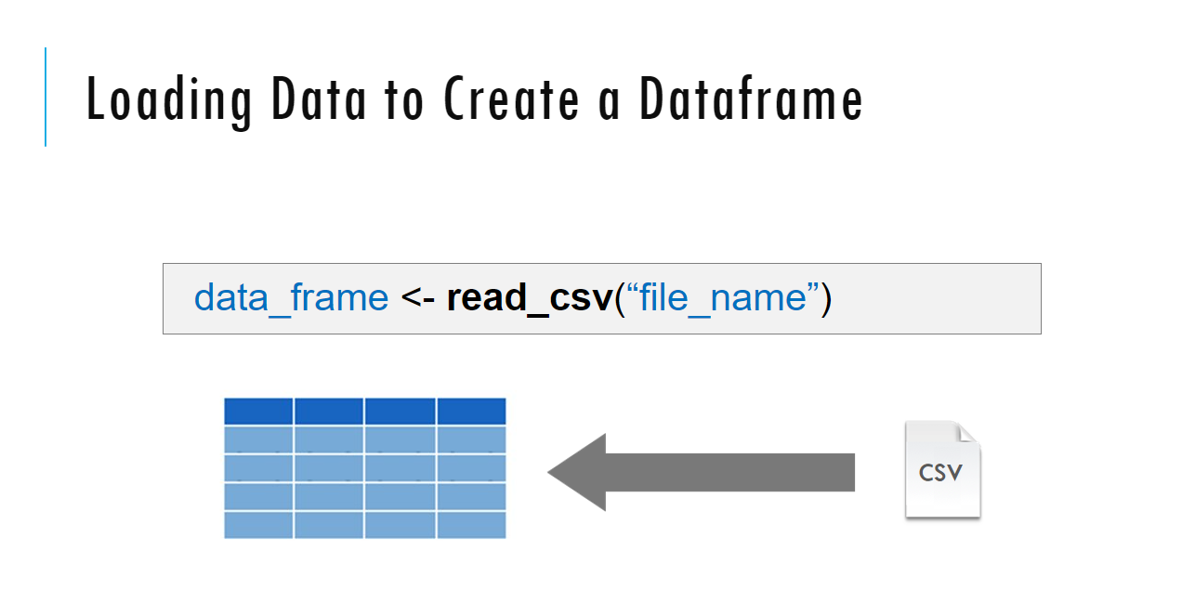
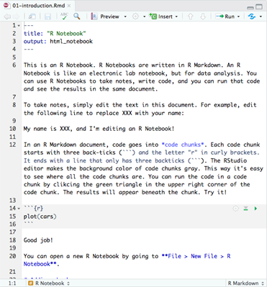
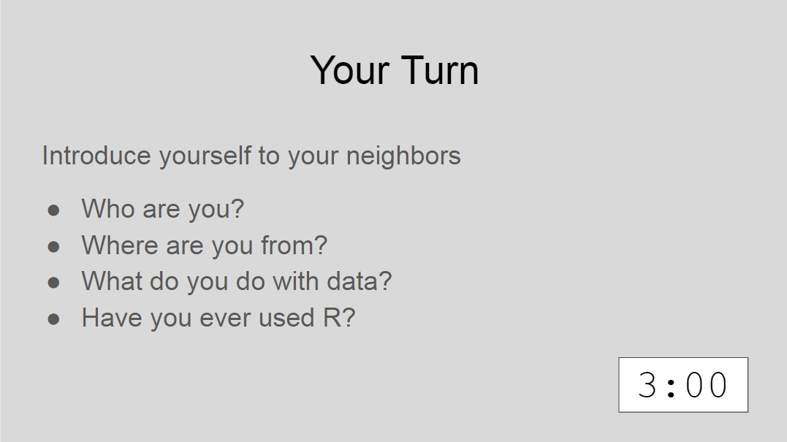
Sessions
Notes:
The meat of the workshop are the sessions each of which will cover discrete subjects or components of R in a data analysis. The sessions have a powerpoint associated with it as well as an R script.
We'll be describing a specific function or topic in the context of the powerpoint – all of which are included in the coursebook and available for download. The same code that is being demoed is included in the R script and you are invited to follow along, run the code, play with it if you like.
At several points in the session we'll have you engage in some exercises which we call Your Turns. In a Your Turn we'll assess how we're doing by asking you to critically think about the topic in the session and respond to a question or do some coding on your own. We'll speak a bit later about how these coding exercises will work.

Slide 29
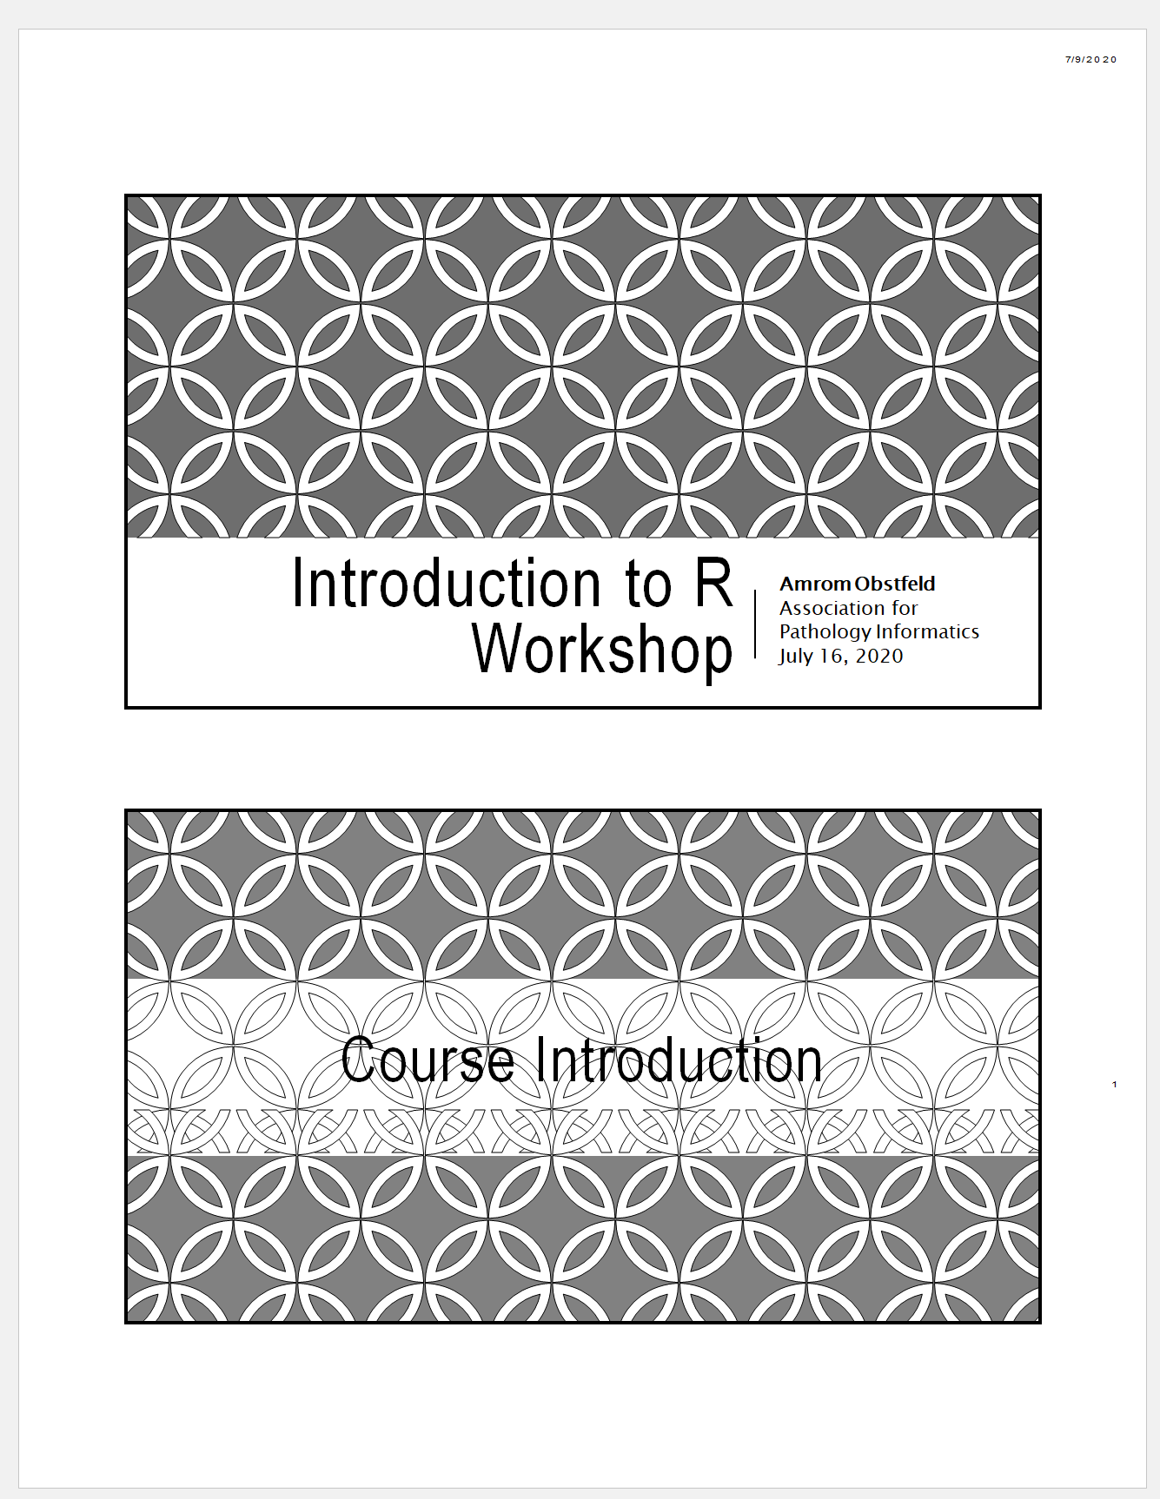
Workshop Coursebook
Coursepack folder on website contains:
PDFs for slides
Cheatsheets
Notes:
The coursebook has all the session powerpoints as well as an appendix that has some additional resources
Cheat sheets are concise one or two page documents that you can use as a quick reference. we'll be referring to these during the sessions. They are also easily googlable and available through the help menu in Rstudio. There is also a one page Useful resources document with links to free online resources like textbooks, videos and courses.

Slide 30

Using Zoom in a hybrid setting
Raise hand in room or virtually for assistance
Remote participants muted
Chat window
Non-verbal feedback
Notes:
Let’s talk a little bit about how we'll be using zoom in this workshop.
During the sessions everyone will be muted other than the instructor. We just want to be make sure we don’t get accidental background noise. But that doesn’t mean that there won’t be opportunities for engagement, we want to make sure that this is an interactive workshop and not a one way street when it comes to interaction.
We will be using the chat window in Zoom we will also be using some nonverbal feedback modalities and we'll be using some breakout sessions during which we'll be doing exercises together in an interactive way, more about all this in a few moments.

Slide 31
Tips for learning
Cheatsheets show how to do common things – orient yourself with them early
The best way to learn to code is by doing
Practice is key!
Programming is hard, even for those with a lot of experience. Find resources and ask for help!
Notes:
And just some final words before we begin, no matter what you're learning but particularly coding, the best way to learn is by doing:
Find a project, make a goal for yourself, push yourself to use R, it's OK to lean on some excel, we all do when we're starting out, but try to get that activation energy to get your hands typing code. We would not be teaching this course if we didn't strongly believe that R is accessible to all of you. So keep practicing and you'll get there.
With that let's get started with the workshop. Up next Joe will provide us with the basics of R and get us up and running with Rstudio Cloud.

Slide 32

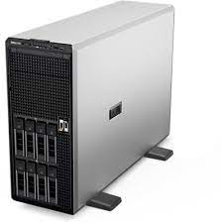
RStudio Cloud will be the Tool For Our R Lessons
RStudio Cloud
Hosted on a server
(in the cloud)
RStudio Server
Hosted on a server (DLMP Server)
RStudio Desktop
Installed locally on your computer
Note: Use RStudio Cloud only for this course. Do not upload protected health information to the cloud!
Notes:
As I just mentioned RStudio can be installed on a server or locally on your computer.
RStudio Server – a version of the RStudio IDE that can be accessed from a web browser. This is what we will use as a training environment today.
RStudio Desktop – a version of the RStudio IDE that is installed on your computer. This is what you should use after the course to continue learning R and working on R projects.
On the course website (https://github.com/pcmathias/AACC-2021-Introduction-to-R), we included links to videos demonstrating how to complete a local install of RStudio Desktop. We also provide access to the course content via a github repository. So though the training environment is ephemeral, you will have access to the course content in the future.
One last reminder, please don’t upload any external data (and especially PHI) to the cloud!

Slide 33
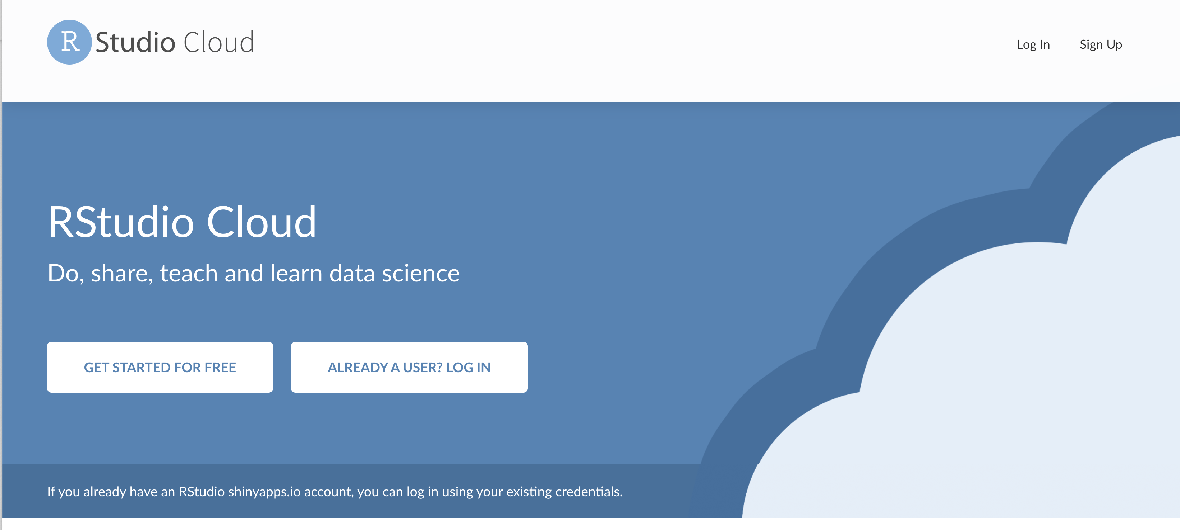
Set up Your RSTudio Cloud Account
Go to rstudio.cloud on your web browser

Slide 34
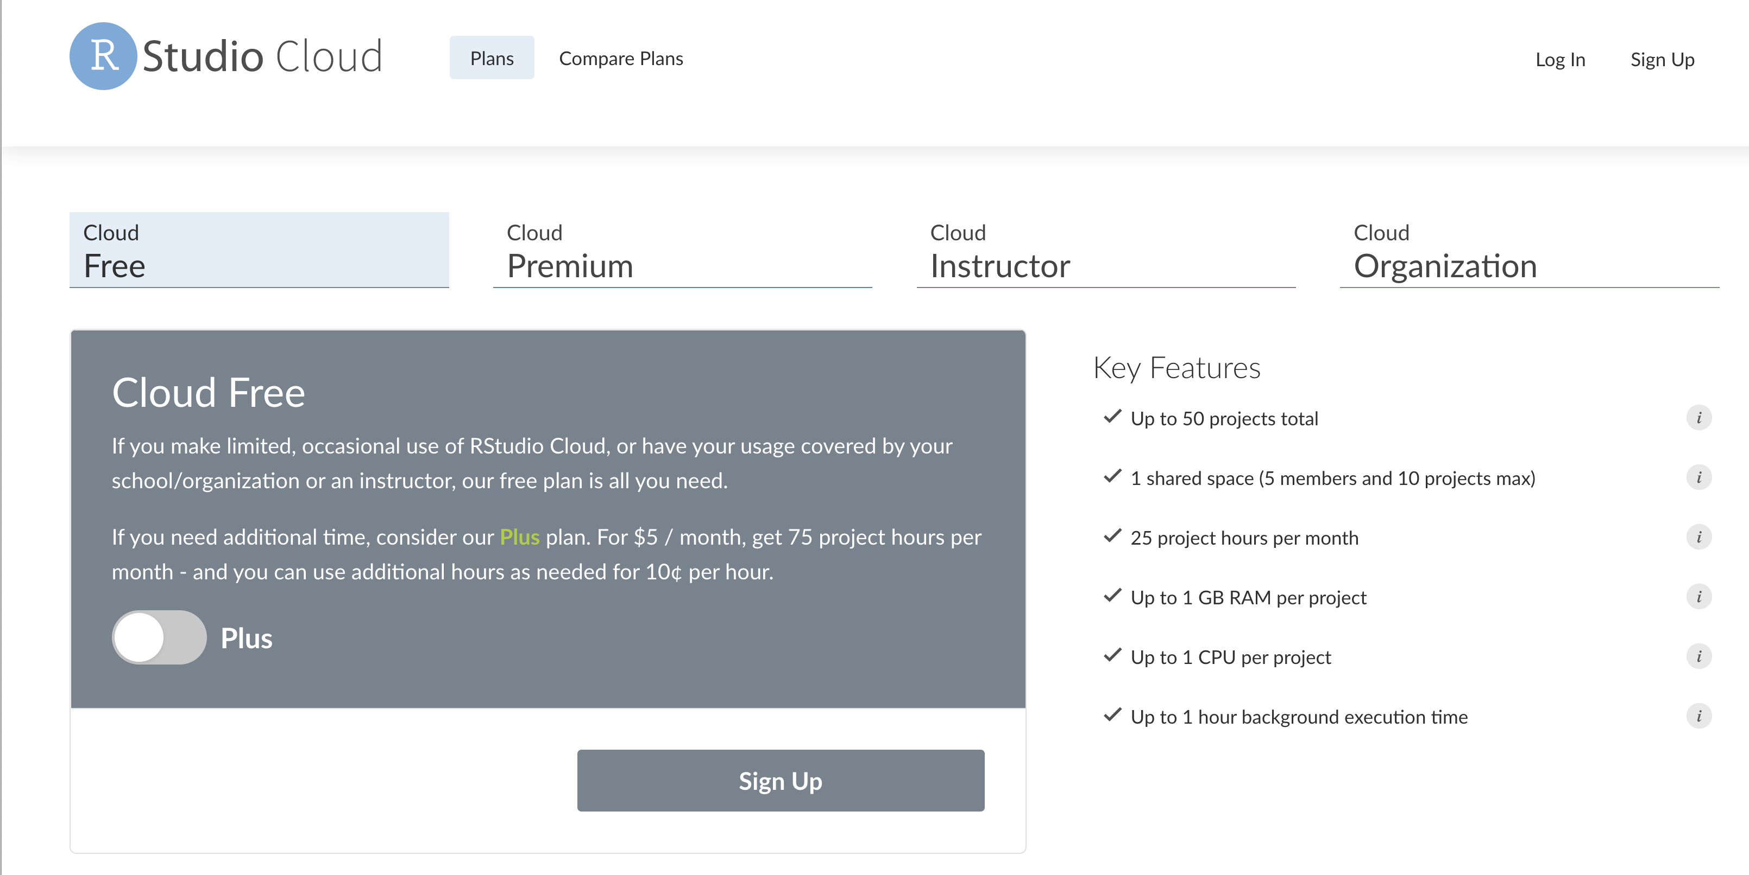
Sign Up for Cloud Free

Slide 35
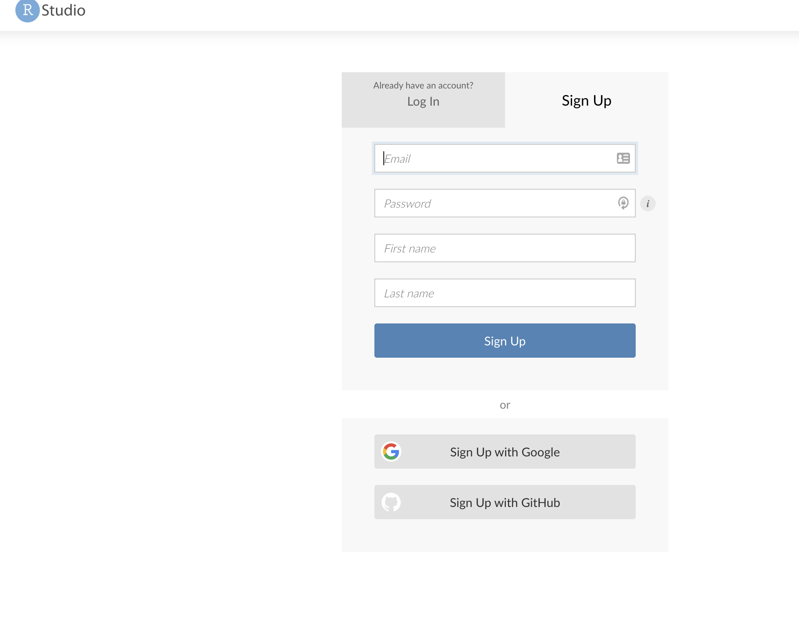
Signing UP with Google Using your UW Email can ShortCut the Setup Steps
Then select your Google account associated with your UW email (if you have Google set up already)

Slide 36

Onward!
Survey link
Will pick up with orientation to RStudio tomorrow
Please fill out survey: https://forms.gle/G6HhAxsHeBXKJtkZ7
Course material available at: https://github.com/pcmathias/dlmp-data-analysis-with-r
After first lessons, we will provide instructions for signing into our DLMP server to use RStudio (without having to install on your local desktop)

